Slide 1
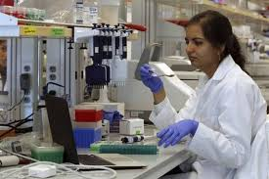
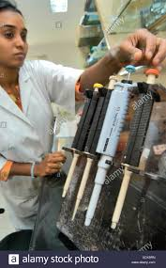
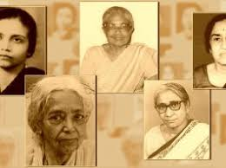
WOMEN IN SCIENCE

Slide 2
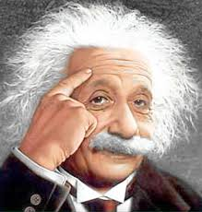
Leadership in Science
‘’Imagination is more important
than knowledge, for knowledge
is limited, whereas imagination
embraces the entire world –
stimulating progress, giving birth to EVOLUTION’’
- Sir Albert Einstein
E = mc²

Slide 3
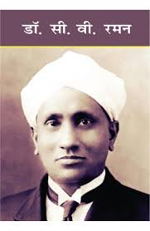
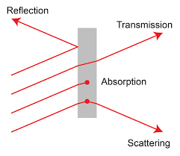
Leadership in Science in Asia
Sir Chandrasekhara Venkata Raman, First Asian Scientist to get honor of becoming Nobel Prize Winner in Physics, was born on Nov. 7, 1888.
Scattering of Light known as Raman Effect Received Nobel Prize in 1930
1888 - 1970

Slide 4
As of 2019, Nobel Prizes have been awarded to 866 men, 53 women (Marie Curie won it twice), and 24 unique Organizations
WOMEN WHO RECEIVED NOBEL PRIZE IN PHYSICS

Slide 5
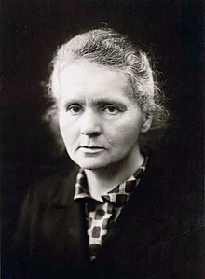
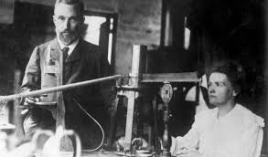
Marie Skłodowska Curie -1903
(shared with Pierre Curie and Henri Becquerel)
In recognition of the extraordinary services they have rendered by their joint researches on the radiation phenomena discovered by Professor Henri Becquerel
“Nothing in life is to be feared,
it is only to be understood”

Slide 6
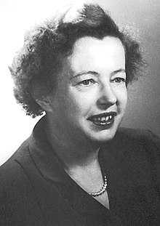
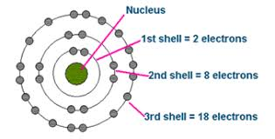
Maria Goeppert-Mayer - 1963
(shared with J. Hans D. Jensen and Eugene Wigner)
Discoveries concerning Mathematical Model of Nuclear shell structure
“Do girls only have to learn how to study to
read cook books”
.”
-

Slide 7
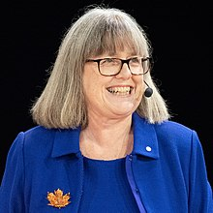
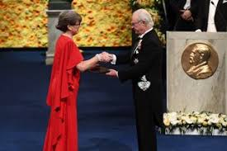
Donna Strickland - 2018
(shared with Gérard Mourou and Arthur Ashkin)
for method of generating high-intensity, ultra-short optical pulses Shared half prize with Dr. Gerard who was her guide and other half was received by Dr. Arthur Ashkin.

Slide 8
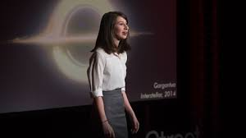
Women in Science – Globally
Women have been contributing actively in science. Recently, Katie Bouman, 29years old scientist, developed a crucial algorithm that helped produce the Black Hole image.
NASA Astronaut, Christina Koch spent 328 days in space ship, the longest continuous spaceflight ever undertaken by a female astronaut.

Slide 9
India’s Position
One of the fastest emerging economies since 2000. Currently 6th largest in the world, aspiring to be 3rd in 2030
Committed to the cause of under-developed and developing nations since its independence
Has 800 Universities and 39,000 Colleges, only 14 Universities are exclusive for women
Yet, participation of girls in Science & Engineering education growing steadily
Glass ceiling is braking through capability, determination and perseverance
Mostly University teaching is in English language

Slide 10
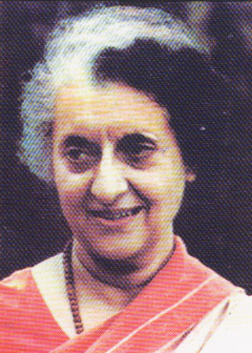
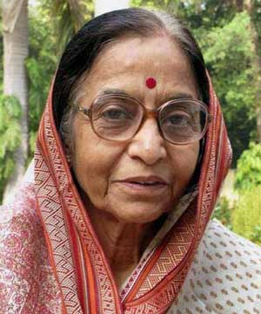
Gender Features Unique to India
Woman Prime Minister in 1960s – Mrs Indira Gandhi
President of India in 2000s – Mrs Pratibha D. Patil

Slide 11
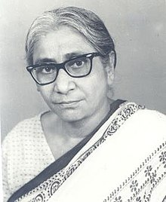
Gender Features Unique to India
Out of three Astronauts of Indian Origin till today, two were women.
Women leaders - are in Parliament, are CEOs in Banking sector, but a few in S&T leadership.
In 2017 all three Mayors in Delhi were women.
Doctorate in science - The first Indian woman Dr. Asima Chatterjee.
Received a master's degree (1938) and a doctoral degree (1944) in
organic chemistry from the University of Calcutta.

Slide 12
General Discrimination
‘ As people rise in their careers, camaraderie often gives way to bitter competition. Male colleagues especially feel threatened by strong, independent-minded women-officers…Women are called bossy, while man with same characteristics are Statesmanlike with Leadership qualities. The civil services are particularly prone to this phenomena ….’
-----------------------First women IAS Topper, Veena Sikri

Slide 13
Opportunities and Constraints (Study 1998)
Traditionally, local societal factors prohibiting career selection in science and technology fields;
Psychological barriers and women’s own preference for non academic jobs, which can be taken up on part time basis;
Lack of family support and double burden as working women, of career and home, due to long working hours in scientific fields;
Six year lag period a young women has to undergo which sometime leads to dissatisfaction in career or complete dropping out;
Lack of career opportunities in the professional fields of engineering and industry;
Employers’ attitude and discrimination in jobs assignments; and
Greater responsibility in top positions which affects social pattern.

Slide 14
DST Task Force on Women in Science
In December, 2005 DST constituted a Task Force for ‘Women in Science’ comprising mainly women as its members. Its main findings were
Percentage of girls studying science in Indian Universities has increased since independence, but ideal share would be 50%.
Percentage of girls appearing in IITs and qualifying are 10% only.
Constitute 37% of Ph.D. in science, 15% in faculty positions and even fewer 4% in getting recognition as Fellows from Academies.
Scientific accomplishments of women are often overlooked and have less visibility.
.

Slide 15
Indian National Science Academy Study on Indian Women Fellows
INSA – 3.3 %
IAS - 4.6%
IAAS - 4.2%
INAE - 1.4%

Slide 16
Main Obstacles to Women Participation in Science
Lack of access to higher education
Glass ceiling everywhere
Psychological barriers among girls
Double standards in the society
Other social factors

Slide 17
Lessons Learnt
Science does not discriminate women
Need to create environment for Women Empowerment
Do not penalize women for career lapses
Give equal opportunity and attention to women education
Give Public recognition for their achievements

Slide 18
Some Success Factors Have been
Commitment to science
Determination
Supportive surroundings
Perseverance
Mentoring opportunities at an early age
Policy support

Slide 19
Climate Change and Gender
“Because women often show more concern for the environment, support pro-environmental policies and vote for pro-environmental leaders, their greater involvement in politics and in nongovernmental organizations could result in environmental gains, with multiplier effects across …………………….”
--- UNDP Human Development Report 2011.

Slide 20
Climate Change is not Gender Neutral
Gender Wage Gap – Vary from country to country
Representation of Women in Energy Boards , Environment and Social Governance
Need to bring women into the planning, financing and implementation of climate responses
Needed Women Leadership and Empowerment
The world still fights with the disparities persisting across the globe due to gender inequality, Climate Change remains not to be immune to such inequalities

Slide 21
Strengthening climate action by promoting gender equality
Women and men are experiencing climate change differently and adapt differently
Recognizing the important contributions of women can lead to successful, long-term solutions to climate change.
Women have proven to be leading the way towards more equitable and sustainable solutions to climate change and increased climate resilience .
Global negotiations have increasingly reflected the growing understanding of gender considerations in climate decision making.
As the world is hustling towards the future threatened by climate change and resource scarcity, the global scientific community must lose no time in recognizing and promoting women scientists’ achievements.

Slide 22
Future is Bright!
Women constitute half of the society
Have a greater role to play in bringing up future generations
Women are more environment conscious
Women sustain energy and are a source of strength
Talent should be nurtured for all – Men or Women
Challenges are there but they are not insurmountable

Slide 23
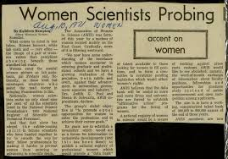
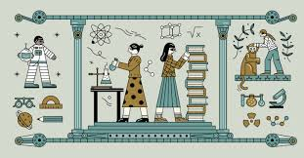
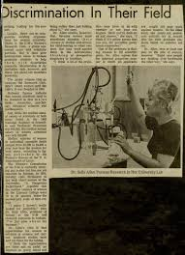
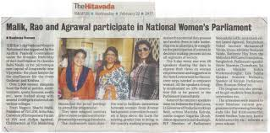
The World needs Science and Science needs WOMEN!

Slide 24
